Slide 1
Data Structures and Algorithms
Where are all the sharks?!
Notes:
Hi, my name is Alicia and I’m a software developer at Nordstrom. Our problem today is to track sharks in the ocean and we’ll solve it using a collection of data structures

Slide 2
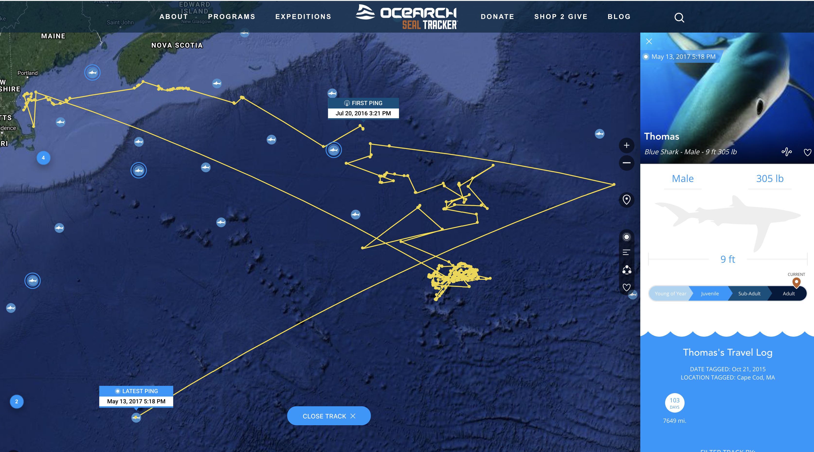
https://www.ocearch.org/
Notes:
There is a website called Osearch that tells you the path of sharks in the ocean over time along with where they are last reported to be. By the end of this, you’ll understand how you can use data structures and algorithms to manage data for an application like this.

Slide 3
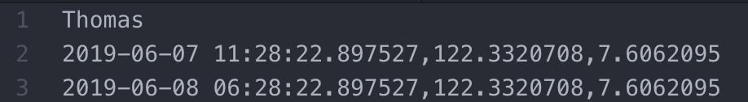
What’s the problem?
We are continually receiving files with information about sharks
We want to answer these questions:
Where was the shark at a particular time?
Where does the shark go most often?
What is the most likely way an shark gets from point A to point B?
If an shark is at point A, where does it usually go next?
NAME
TIME,LONGITUDE,LATITUDE
Notes:
Let’s get into the details. We’re receiving the location information of the sharks in CSVs where each line tells us the time, longitude, and latitude of a transmission. The file data will not be sorted. I won’t cover how we’re receiving these files. Some examples of how this might work is pulling data from the cloud every few minutes, having a service call that sends the file to us, or a human downloading the file. Given this data, we want to answer a few questions: where was the shark at a particular time, where does the shark go most often, what is the mostly likely way a shark gets from point A to point B, and if a shark is at point A, where is it most likely to go next? As you can imagine, we really want to know this information for beach closures and protecting shark migration by shutting down trade routes.

Slide 4
What’s covered
Maps
Lists
Queues
Stacks
Trees
Graphs
Search
Sort
Graph search
Notes:
On the left are the data structures I will cover and on the right the algorithms. This is a lot of content so we may not get through all of it. I have the code I’m going to show on github and I’ll leave that information on a slide at the end. The code I’ve written is not production or interview quality because I’ve tried to write it in a more understandable way.

Slide 5
Why and why
Custom behavior for your application
You can’t use certain libraries
You have a job interview (TODO )
Understanding libraries and debugging
Notes:
Two questions: why wouldn’t we use Python libraries or data types already implemented and why do we want to know this at all? Python makes some of these structures really easy and there are libraries out there that provide alternative implementations. However, you may find yourself rewriting them on your own because your application is slightly different that what the libraries solve, you can’t use the libraries because of security or company policy, and finally, if you have a job interview. Lastly, understanding how these work will help you make better decisions on what libraries to use and how to fix issues if any come up.

Slide 6

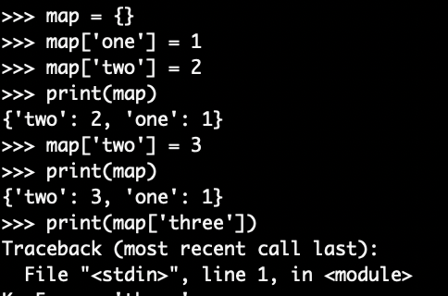
Maps
Operations
Put
Get
Delete
Collisions
When two values have the same key
Notes:
Let’s start of simple with Maps. In Python we call these dictionaries and you should see some familiar code on the right. Maps are key-value stores where you store a value under a key. An example might be storing a Spanish-English dictionary where the key is the Spanish word and the value is the English word. The primary operations are called Put, Get, and sometimes Delete. When two values have the same key, i.e. a Spanish word has multiple English translations, that is called a collision. Python Dictionaries will take the new value and discard the old. In the example I will show you, we will keep both values in a list so we don’t lose any information. Finally, notice that when you try to get a key that hasn’t been added, Python will give you an error. My implementation will also change this.
Show AnimalTracker in demo
Go over Animal Tracker class

Slide 7
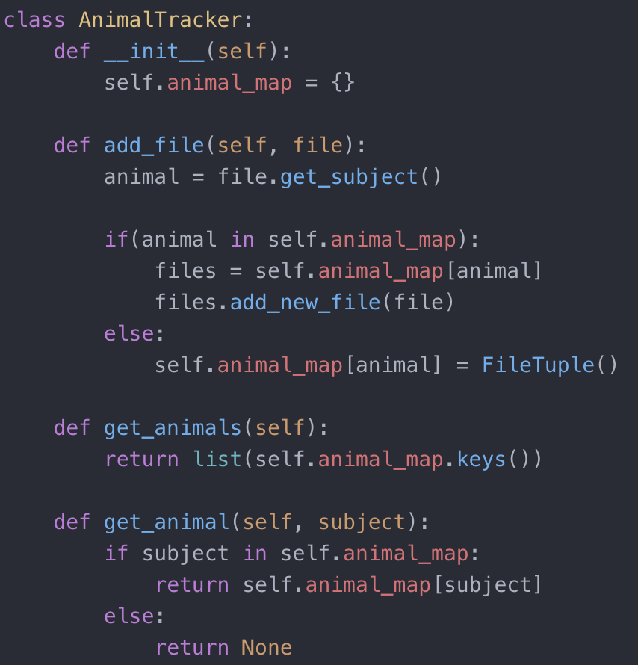
Different add rules: A new item is added to a custom data structure following specific rules
Different existence rules: Items that don’t exist return None instead of an exception
Key = animal name
Value = set of structures holding animal data

Slide 8
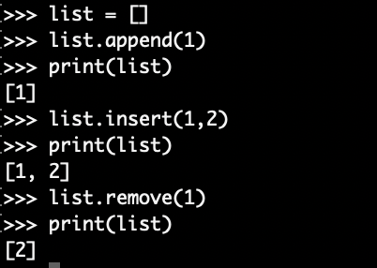
Lists
Ordered sequence
Single linked: traverse only in one direction
Double linked: traverse in two directions
Circular: the last item points to the beginning
Operations: add, remove, get
Notes:
Lists are next: as you saw in the code, we are referring to a list to keep track of files we’ve already sorted. List are ordered sequences of objects. In Python on the left, it’s pretty easy to create, add and remove. When we implement our own lists, we talk about linking. A link is how one object “knows” where it is in the list. A signle linked list means the object only knows what the object next is going to be, i.e. you can only go forward. A double linked list is where the item “knows” it’s previous and next neighbors. This means you can go backwards or forward. Finally, circular is a list where the next element of the last item is the first item in the list so you can just keep going around when you are looping through.

Slide 9
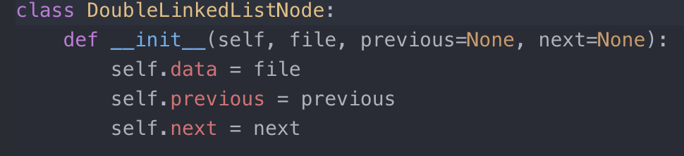
Next
1
2
3
None
Previous
None
The example is using lists to hold sets of data files for each animal
Notes:
Let’s draw this out. We have each object in the list stored in a node (you can call it element too). In my example, we have a double linked list and each node or element stores the data, it’s previous, and it’s next.

Slide 10
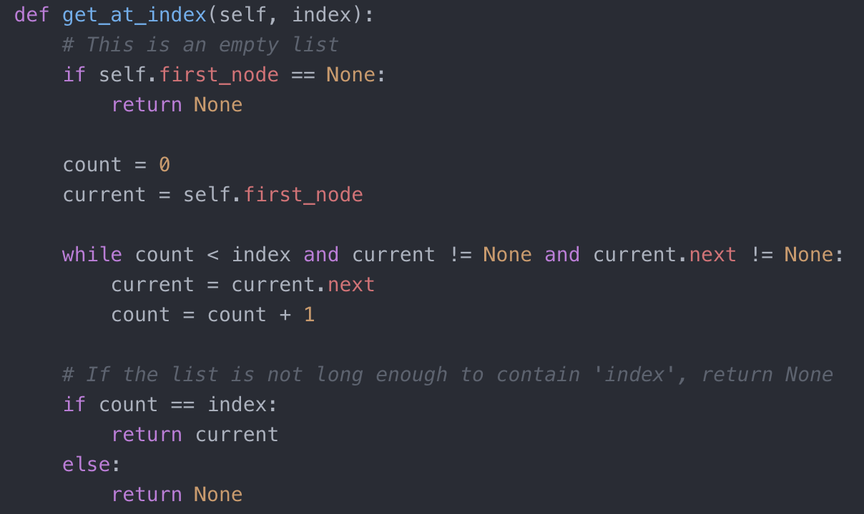
Notes:
Show get in code. Show insert in code. Draw out both.

Slide 11
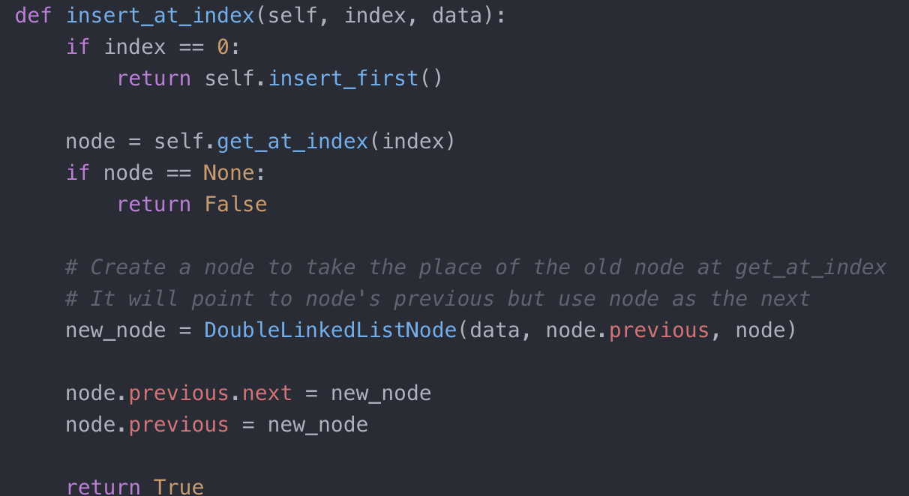

Slide 12
Stacks and Queues
PUSH
D
2
C
1
B
0
A
Lists with specific add and remove rules
Operations:
push (add),
pop (remove),
peek (show the next value)
(LIFO) Stack: push always adds at index 0 and pop always removes at index 0
(FIFO) Queue: push always add to the end and pop always removes at index 0
QUEUE
STACK
3
D
3
D
2
C
2
C
1
B
1
B
0
A
0
A
2
D
2
C
1
C
POP
1
B
0
B
0
A
A
D
Notes:
Stacks and queues can be thought of a lists where you have special rules for adding and removing items. For this example they will be lists but they don’t always have to be. There are other structures you can use for them. The operations are push, pop, and peek. Pop will remove the next item, push will add an item, and peek will return the next item without removing it.
The rules for a stack are that you can only add to the end of the list and only remove from the end of the list. This means the last item in is the first item out or LIFO
The rules for a queue are that you can only add to the end of the list and remove from the start. This means the first item in is the first item out or FIFO
In the diagram, you can see both add to the end but the queue removes from the start and the stack removes from the end.

Slide 13

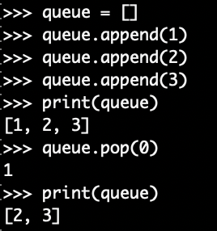
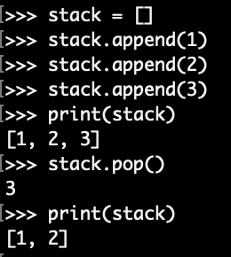
Stacks and Queues in Python
Notes:
You can fairly easily implement these as lists in Python and it has a pop method that will return and remove an item. By default, it works like a stack but you can use indexes to use it as a queue

Slide 14
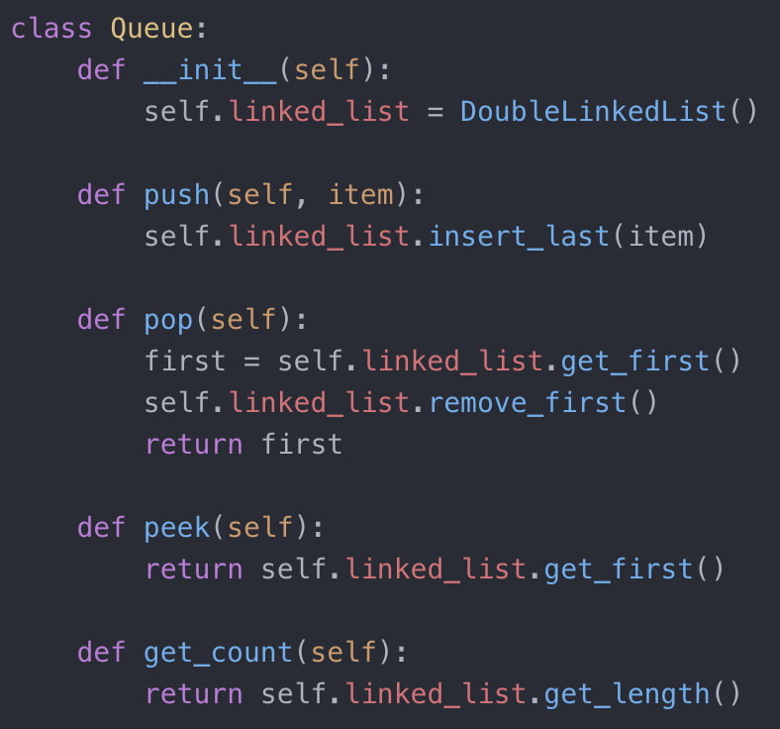
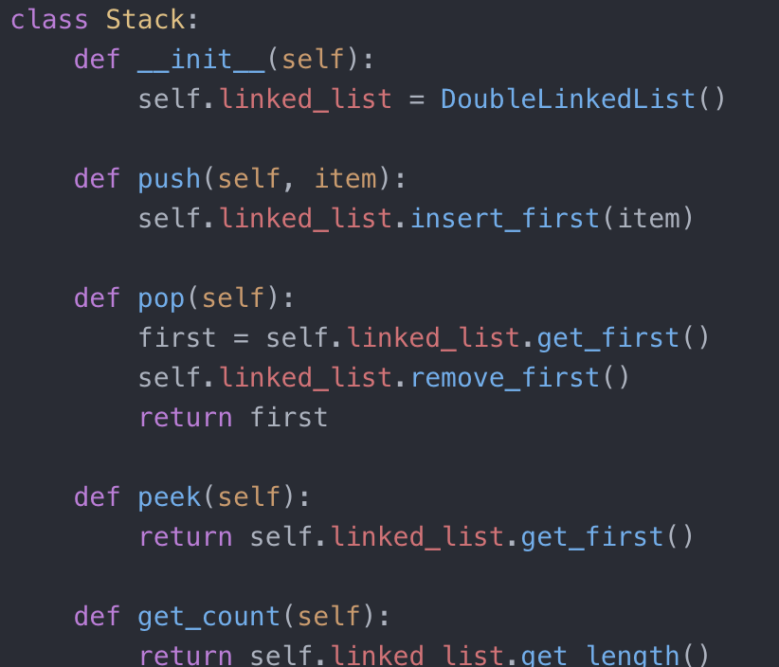
Stack/queue
The example is using stacks and queues to hold new files. If we are interested in a shark’s recent location data first, we use a stack. If we are interested in historical data first, we use a queue.
Notes:
Go over an alternative implementation of push and pop. Instead of always adding to the end, both always remove from the start and for the stack I insert at the start and for the queue I insert at the end

Slide 15
Sorting
Insertion Sort: for each item, insert it into the sorted list where it fits in order
Merge Sort: Split the list in half and sort each half before merging. For a list of size 1, it is sorted.
Quicksort : Pick a number n from the list. Put all numbers less than n on the left and greater on the right. Quicksort the left and right then merge. For a list of size 1, it is sorted.
For this example, we want to take each received file and sort it so that we can more easily search the data and also construct a timeline of the shark’s path
Notes:
Sorting is a common algorithm about putting items in order. Three common ones are Insertion Sort, Merge Sort, and Quicksort. The main differences between sorting algorithms are how fast you can do it and how much space it takes.
Here’s a quick summary of what they do. Insertion sort is where you add one item at a time to the sorted list, moving along the list and inserting it where it fits.
Merge sort splits the list in half and sorts each half. Keep splitting until you get to one and it’s sorted. Most of the work is done merging the halves back together into a bigger sorted list.
Quicksort is usually faster than insertion sort and merge sort, thus the name. Think of it like this: you pick a random number in the list and divide the list into two groups: greater than your number and less than your number. Sort those halves and concatenate them at the end.
Let’s look at implementation.

Slide 16

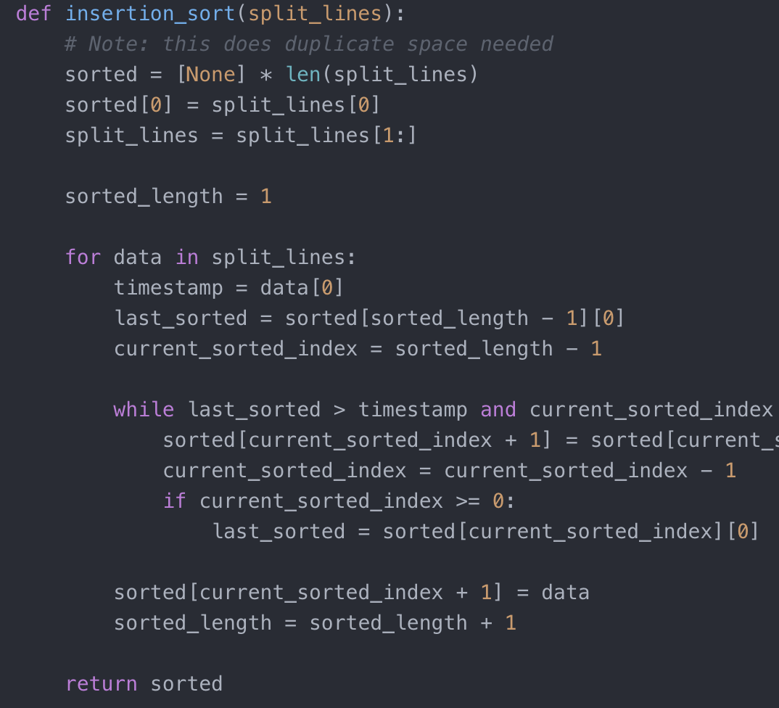
Insertion Sort

Slide 17
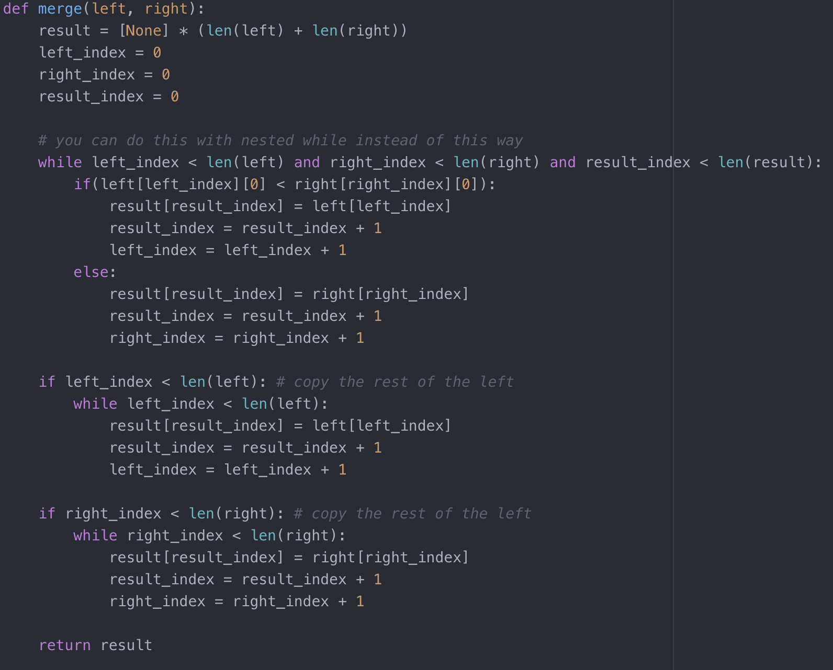
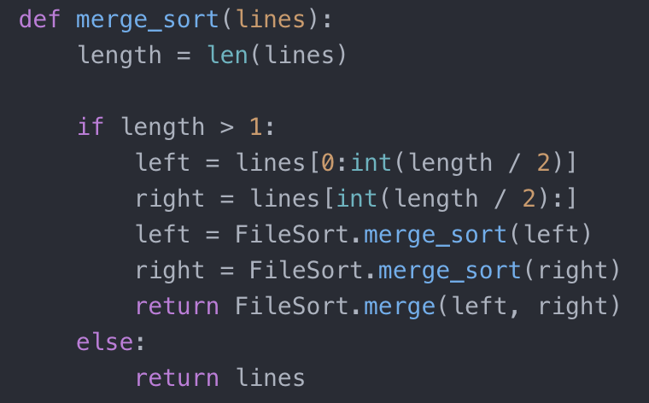
Merge Sort

Slide 18
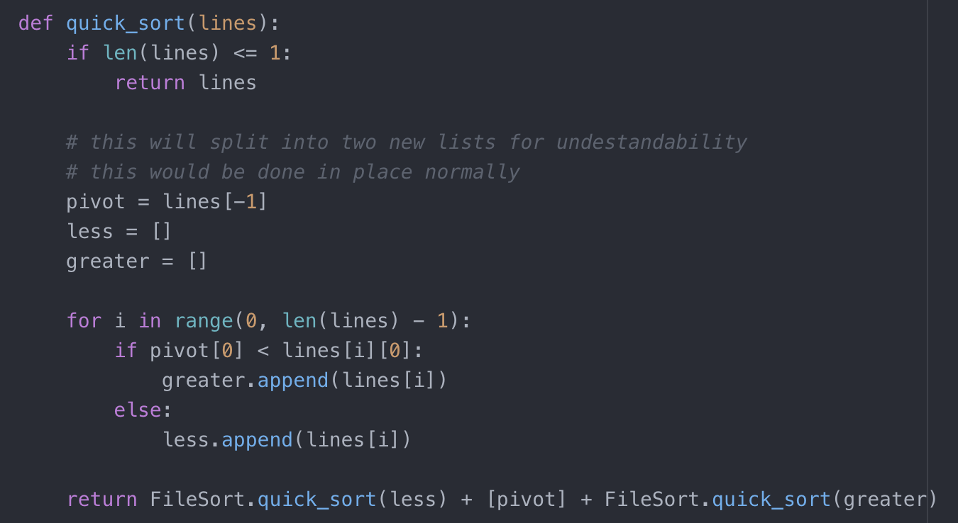
Quicksort

Slide 19
[binary search] Trees
7
Vocabulary:
Node
Edge
Parent
Child
Root
Leaf
Trees are:
Acyclic
Directed
2
15
-3
5
9
-5
1
4
6
8
11
Notes:
Trees are a structure where you can represent a hierarchy. They are a subtype of the graph data structure which describes relationships between objects (later). Trees have nodes (also known as vertices) and edges. A node stores data and an edge connects two nodes. An edge can be one way or bidirectional. A one way edge is called directed. Tree nodes usually have a parent and children, just like a family tree. The node which starts the tree is called a root node. A root node has no parent. A leaf node is a node with no children. The height of a tree is the number of nodes or hops from the root to a leaf node. It is the longest path in the case of an unbalanced tree. An unbalanced tree is one where you might just have a diagonal going all the way down one side. Trees are acyclic. This means you can’t travel around the tree and get stuck in a circle.
Binary search trees are special type of tree where each node has a maximum of two children (thus binary) and for values you can sort or compare, a node’s left child is always less than the node and the node’s right child is always greater than the node. This means you can search very quickly through this structure because you don’t need to look at all the elements to find something. In this example if it were a regular sorted list, to find number 5, you would search from -5 up to 4, which is 5 nodes looked at. If you use binary search, you would look at the seven and go left. Look at the 2 and go right. That’s 2 nodes looked at instead of 5.

Slide 20
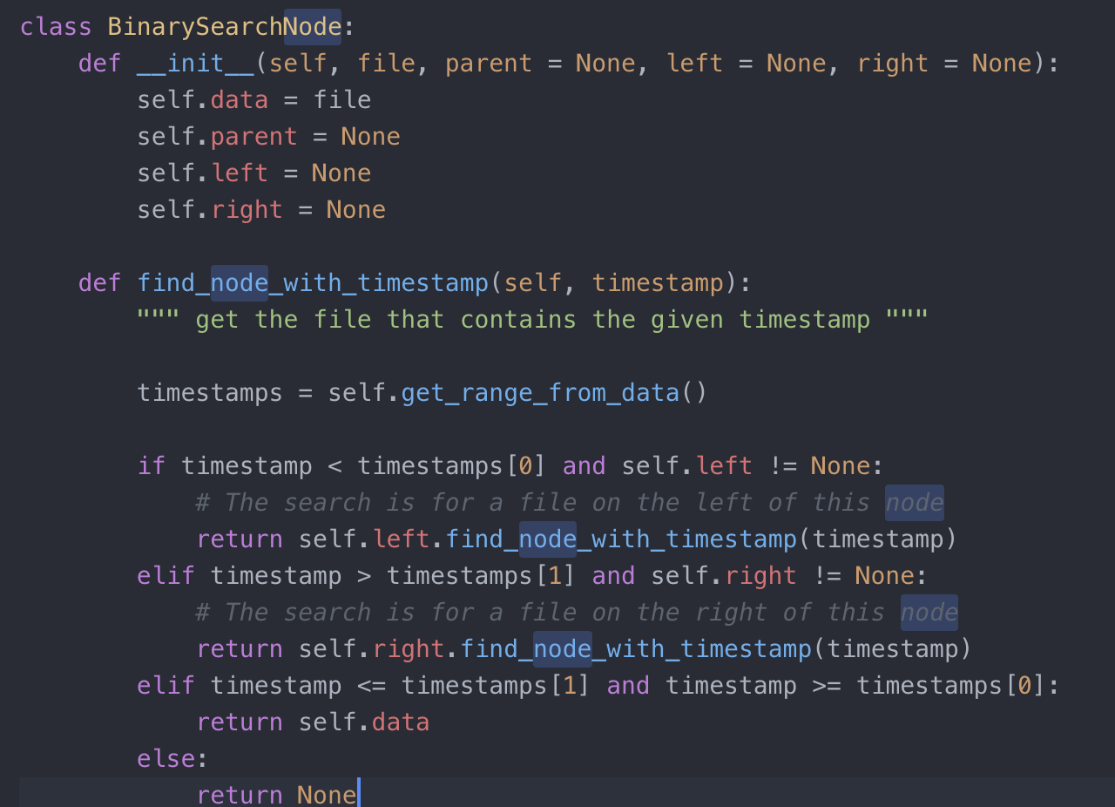
Searching
For this example, we put our sorted data in a binary search tree and can then get the location data for a specific timestamp

Slide 21
Graphs
A
B
Like a tree: nodes, edges
More generic: neighbors and undirected
Path: a set of nodes or edges defining a traversal sequence in the graph
In this example, we use the time sorted data to create a path of where a shark travels
E
C
D
F
Notes:
Graphs are similar to trees in that they have nodes and edges but they are more generic. Instead of having rules around directed edges and no cycles, you can have whatever you want, direct/undirected, cycles or no cycles. In this example, we are using a graph to represent the shark’s movement over time. Each node is a longitude and latitude where the shark as been and an edge is created when a shark move from one location to another. A path is a sequences of nodes where each node in a sequence has an edge to the next node in the sequence. For a shark, a path would describe his or her motion over time.

Slide 22
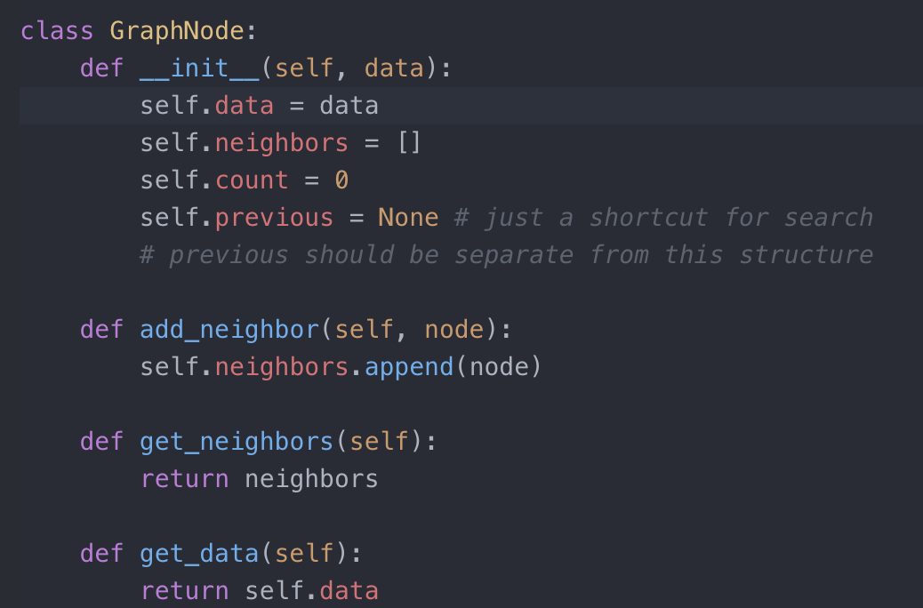
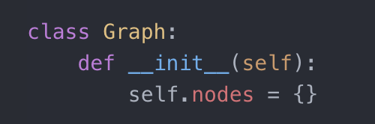
Graphs
The graph is a map of nodes with key: coordinates and value: node object
The node object contains information about how many times this location has been visited and where the shark was before and after being at this location
The previous field will be used in tracing a search path

Slide 23
Graph Search
A
1
BFS: 3
B
Search starts with one node and then goes to their neighbors
Then those neighbors add their neighbors and so on
When you find your target, you stop
Breadth first: Search the “closest” nodes first
Will find shortest path
Depth first: Search the furthest nodes first
Will find any path (faster)
Cycles: prevent infinite loops by marking what is visited already
E
C
2
D
DFS: 3
F

Slide 24
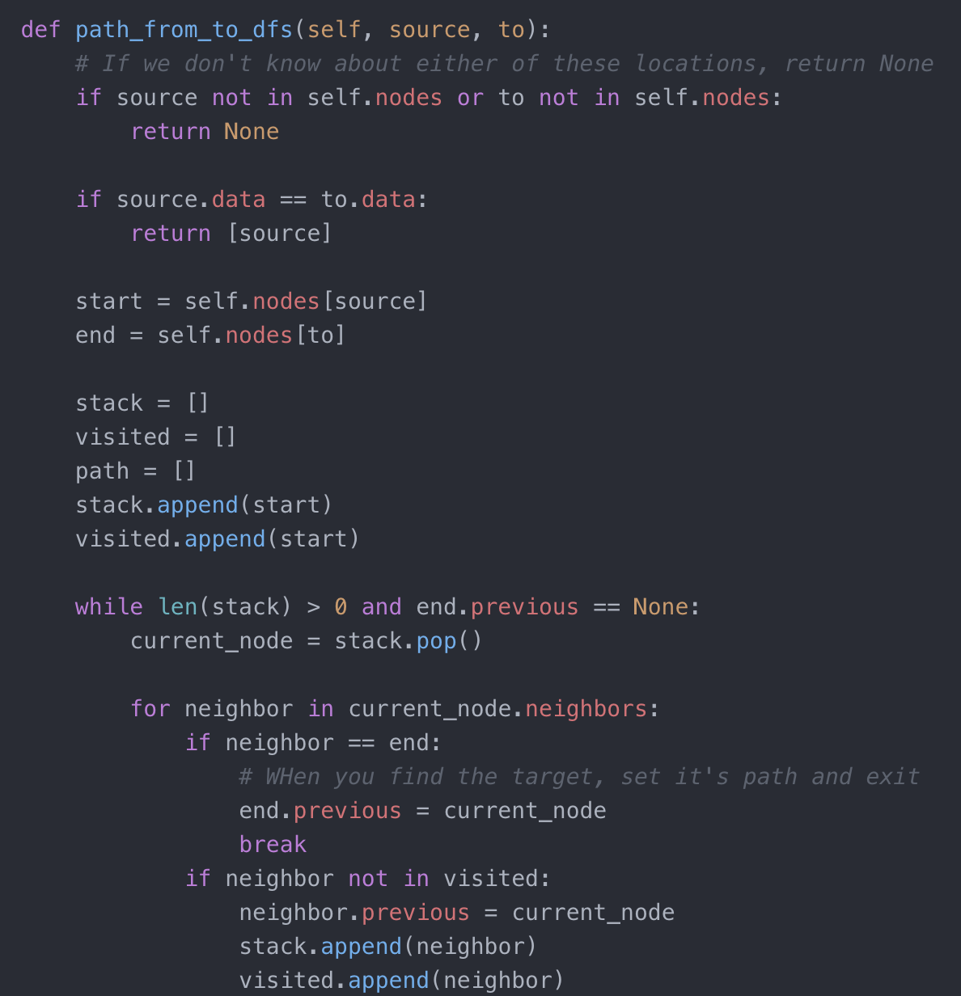
SEARCHING
The difference between BFS and DFS is a queue or a stack for your neighbors

Slide 25
Thank you
Slack – Pyladies: Alicia B
Github: albendz
LinkedIn: abendz
https://github.com/albendz/sideProjects/tree/master/file_manager

